Slide 1
Heart Disease Power BI Dashboard Project
Group Project No. 4

Slide 2

Group Members
Meet The Team
Eng. Mahmoud Abd Elraof Mohamed
Eng. Hussien Abd ElHaliem Bedier
Eng. Mohamed Gomaa Rabea
Eng. Ahmed Ibrahim Elsayed
Eng. Assem Ahmed Khalifa
Dr. Esraa Hamdeno Abd Elkader
Supervisor: Eng. Kareem Bakli

Slide 3
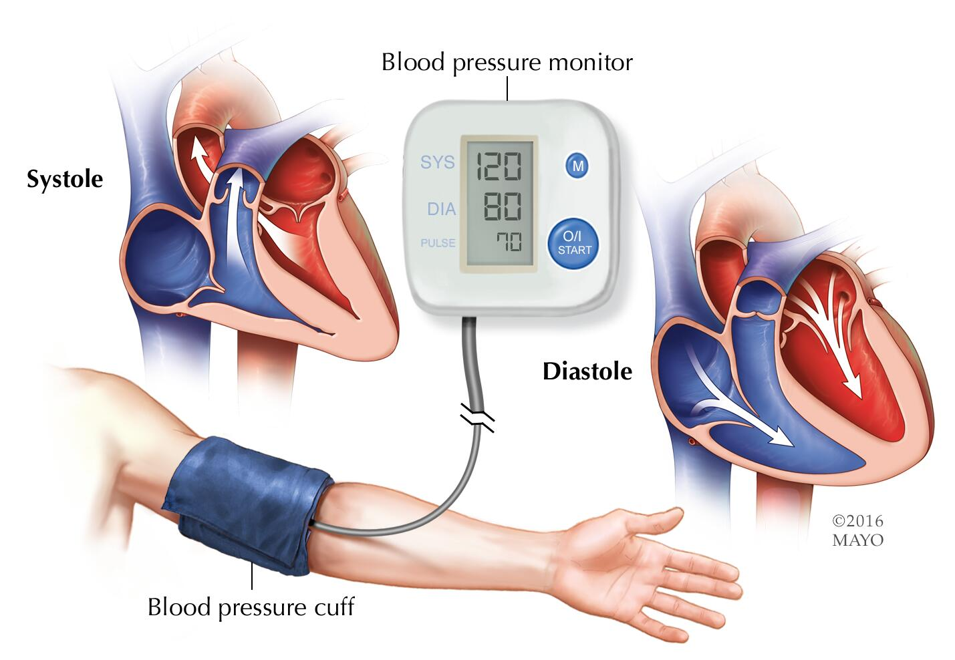
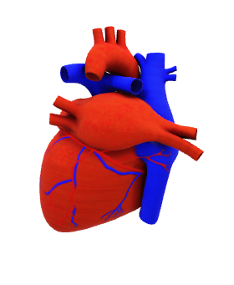
Project Overview and KPI’s
Objective:
Cardiovascular diseases → #1 global cause of death (>17.9M deaths/year).
Objective: Predict heart disease using demographics, lifestyle, and health indicators.
Target variable: cardio (1 = Disease, 0 = No Disease).
Analysis KPI’s:
** Demographics Page: Including patient basic details (Age, Gender, Height, Weight):
Heart Disease Distribution by Gender
Average Blood Pressure by Age Group
Relationship Between Body Mass Index (BMI) and heart disease
** Lifestyle Page : Including patient lifestyle details (Smoking, Alcohol, Physical Activity):
Effect of Smoking and Alcohol Consumption on Heart Disease
Impact of Physical Activity on Heart Disease Prevention
Analysis of Combined Risk Factors Leading to Heart Disease (e.g., Smoking + High Cholesterol + Low Physical Activity)
** Health Indicators Page : Including Patient Healthy measures (Cholesterol, Glucose, Blood Pressure):
Impact of Cholesterol Level on Heart Disease
Heart Disease Prevalence Rate
Trend of Heart Disease Cases by Age Group
Correlation Between Glucose Level and Heart Disease

Slide 4
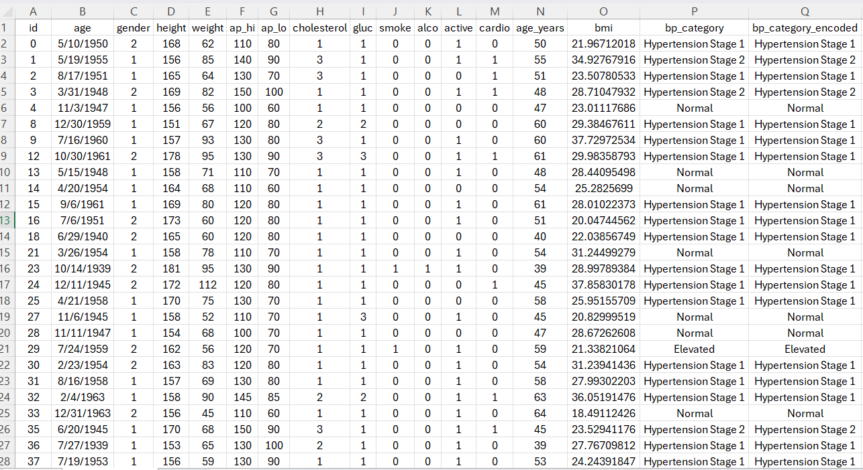
Data Overview
Dataset: Contains real-world medical data from 68,206 patients.
Key Variables:
Demographics: Age, Gender, Height, Weight.
Lifestyle: Smoking, Alcohol, Physical Activity.
Health Indicators: Cholesterol, Glucose, Blood Pressure.
Target Variable: cardio (1 = Disease, 0 = No Disease).
Summary of Data type
No of Columns | Data Type
1 | Primary Key
1 | Date
7 | Binary
5 | Numbers
2 | Text

Slide 5
Data Explorations Rows : 68206 row Columns: 17 column
ID
Primary Key رقم المريض (تعريفي فقط)
Age
Date تاريخ ميلاد المريض
Gender
Height & Weight
Binary number 1 = ذكر، 2 = أنثى
Decimal number وزن وطول المريض
Ap_hi
Ap_lo
Whole number ضغط الدم الانقباضي (الرقم الكبير في قياس الضغط)
Cholesterol
While number ضغط الدم الانبساطي (الرقم الصغير)
Gluc
Binary number مستوى الكوليسترول: 1 = طبيعي، 2 = أعلى من الطبيعي، 3 = عالي جدًا
Smoke
Binary number مستوى السكر: 1 = طبيعي، 2 = أعلى من الطبيعي، 3 = عالي جدًا
Alco
Binary number مستوى السكر: 1 = طبيعي، 2 = أعلى من الطبيعي، 3 = عالي جدًا
Active
Binary number هل بيشرب كحول (0 = لا، 1 = نعم)
Cardio
Binary number هل نشيط بدنيًا (0 = لا، 1 = نعم)
Age_years
Binary number هل عنده مرض قلب (1 = نعم، 0 = لا)
BMI
Whole number عمر الشخص بالسنوات
Bp_category
Decimal number مؤشر كتلة الجسم = وزن/طول² (يقيس السمنة)
Bp_category_encoded
Text تصنيف الضغط Normal, Stage 1, Stage 2 and Elevated
Text تصنيف الضغط Normal, Stage 1, Stage 2 and Elevated

Slide 6

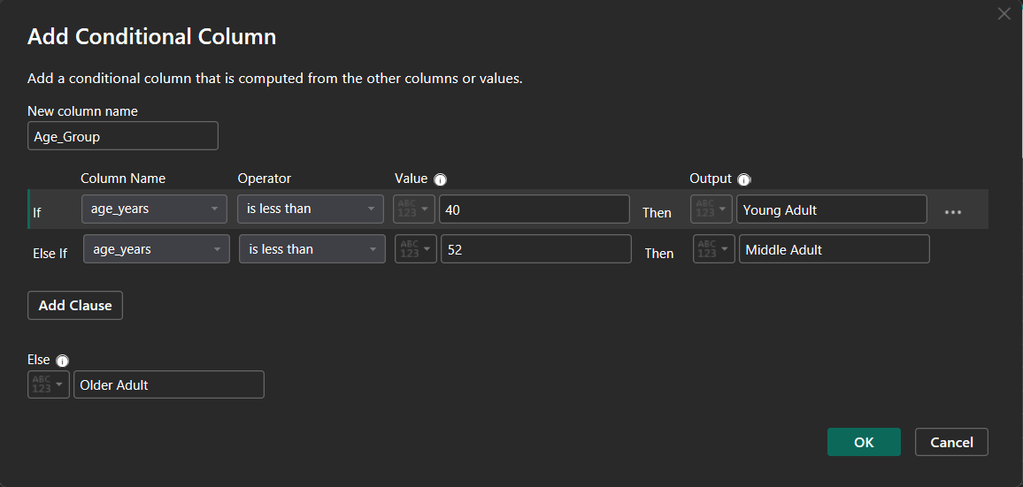
1. Data Preparation
Making Data Preparations:
1. Categories Age: Converted Age years to Age Stages.
Outcome: A clean dataset with human-readable labels and enriched features.
2. Delete Duplicated Data: bp_category, bp_category_encoded
As we found both columns give the same data

Slide 7
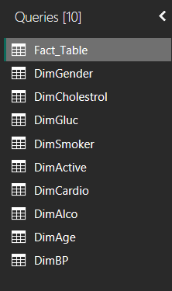
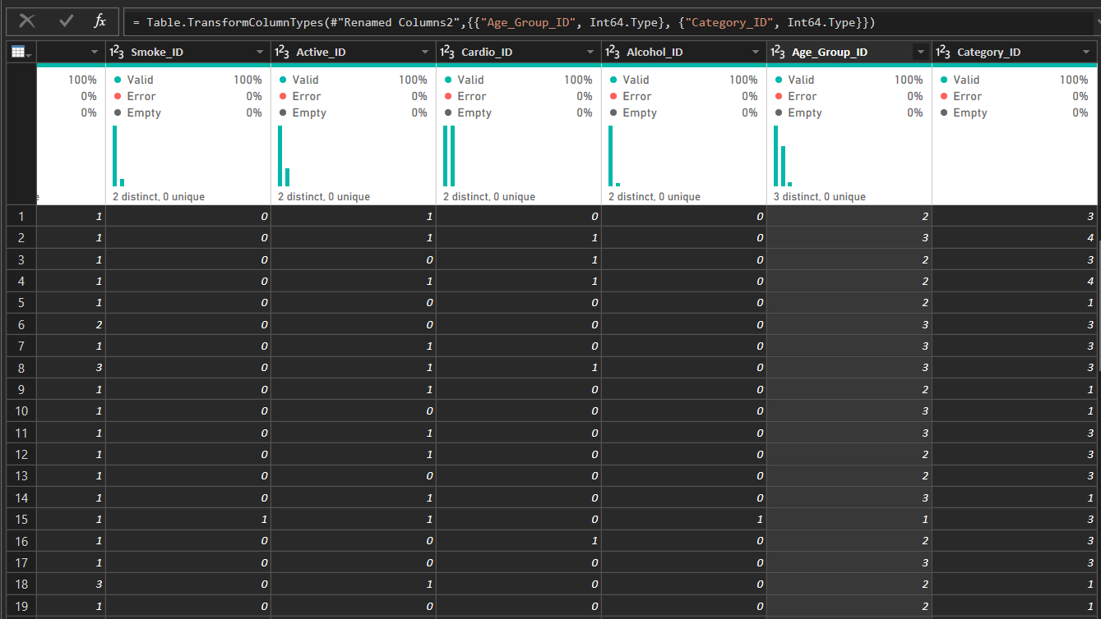
2. Data Modeling – Star Schema Fact & Dimension Tables
Schema Contain 1 fact table and 9 Dimensions

Slide 8
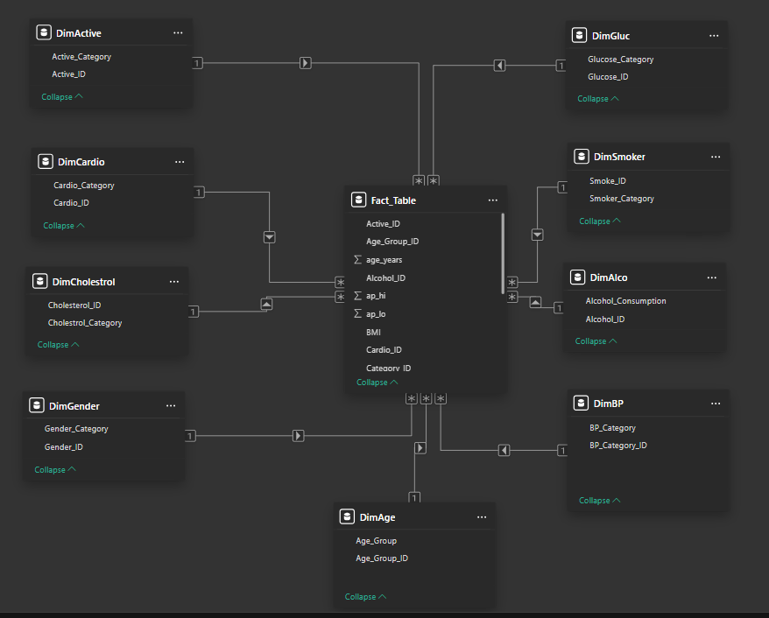
3. Data Modeling – Star Schema Relation – One to Many

Slide 9
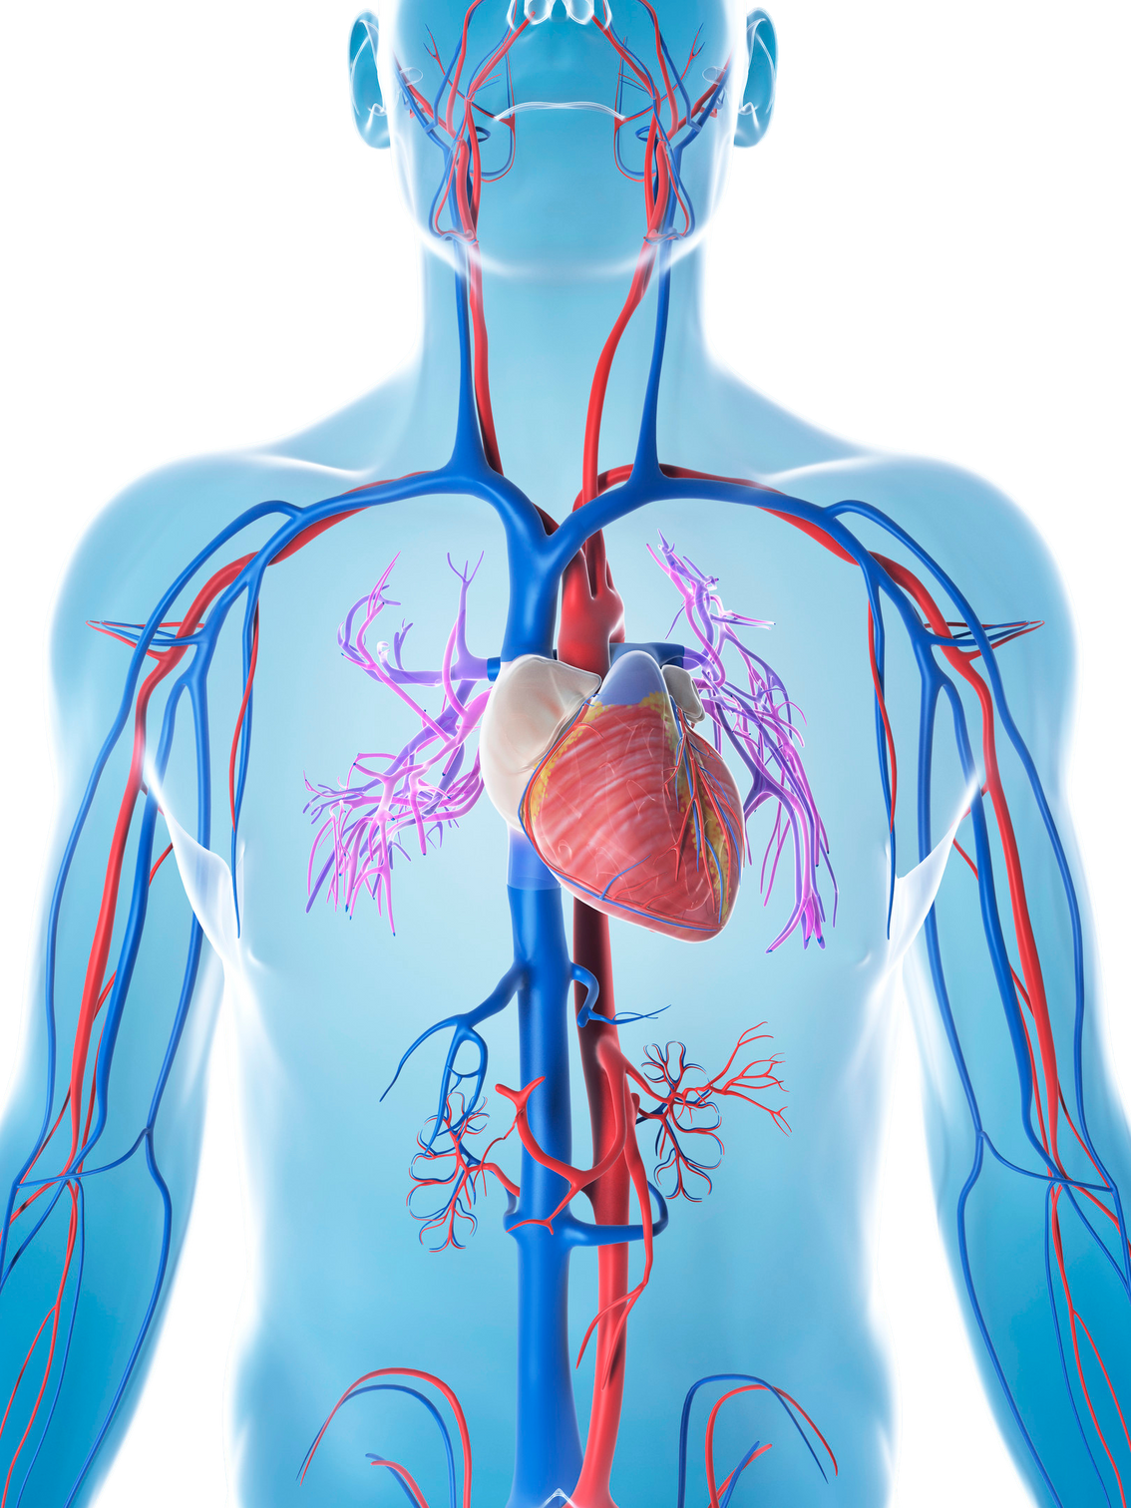
Big Thanks
Heart Disease Power BI Dashboard Project
Group Project No. 4

